Slide 1
Heart Failure
An early warning detection Model & application
created by Gabriel Allen & Noah Laraway

Slide 2
CONTENTS
Executive Summary
Data Source
Exploratory Data Analysis
ML Model Development
Model Selection
Feature Selection
Hyper Parameter Tuning
Application Development
Technologies
Architecture

Slide 3

EXECUTIVE SUMMARY
According to the Centers for Disease Control and Preventions’ National Center for Health Statistics, heart disease is the most common cause of death in the United States. Cardiovascular diseases (CVDs) are the number 1 cause of death globally, taking an estimated 17.9 million lives each year, which accounts for 31% of all deaths worldwide. Heart failure is a common event caused by CVDs and this dataset contains 12 features that can be used to predict mortality by heart failure.
The use case of this project is to help warn medical professionals and patients of a potential heart failure event by developing a robust rapid screening model and deploying that model to an interactive portable application.

Slide 4
DATA SOURCE
Chicco, D., Jurman, G. Machine learning can predict survival of patients with heart failure from serum creatinine and ejection fraction alone. BMC Med Inform Decis Mak 20, 16 (2020). https://doi.org/10.1186/s12911-020-1023-5
Proposed Two-Factor Warning System (Serum Creatine & Ejection Fraction)
Open-source CSV data located on Kaggle
Attributes
Age – Age of patient in years
Anemia – Binary classifier for pre-existing condition
Creatine Phosphokinase - Level of the CPK enzyme in the blood (mcg/L)
Diabetes - Binary classifier for pre-existing condition
Ejection Fraction - Percentage of blood leaving the heart at each contraction (percentage)
High Blood Pressure - Binary classifier for pre-existing condition
Platelets - Platelets in the blood (kiloplatelets/mL)
Serum Creatine - Level of serum creatinine in the blood (mg/dL)
Serum Sodium - Level of serum sodium in the blood (mEq/L)
Sex - Binary classifier for gender
Smoking - Binary classifier for pre-existing condition
Time* – Follow up period in days from test panel (*omitted from analysis)
Death Event – Binary classifier for target event

Slide 5
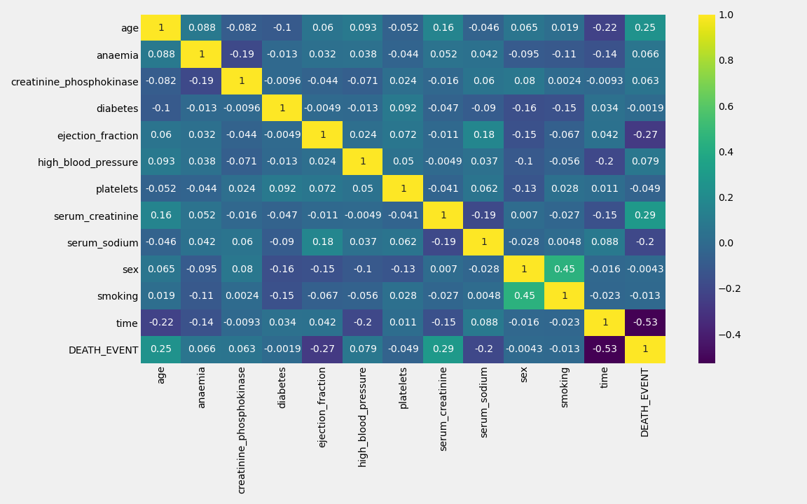
EXPLORATORY DATA ANALYSIS

Slide 6
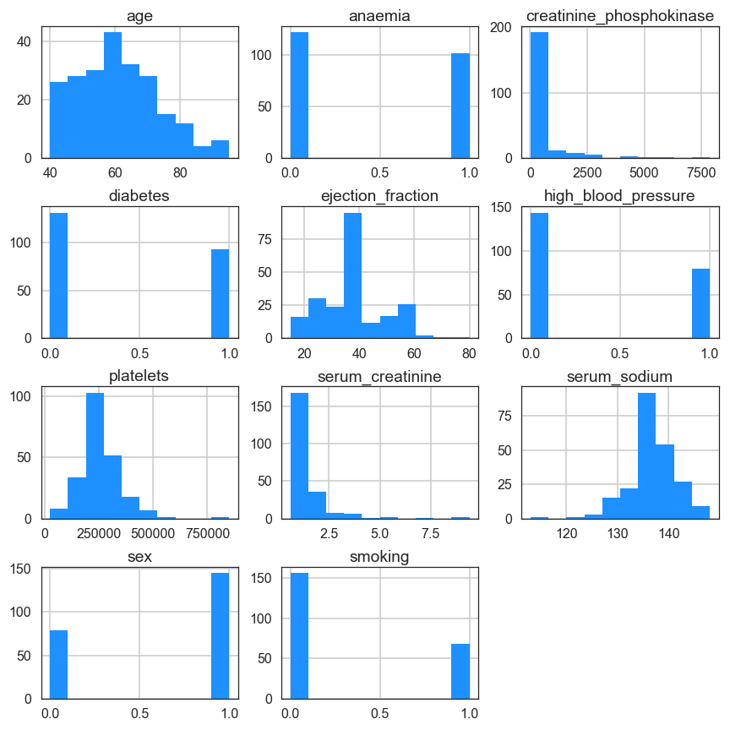
EXPLORATORY DATA ANALYSIS
Balance Evaluation
Continuous variable distributions appear to be roughly balanced with no bi-modal frequency distributions
Categorical variable appear roughly balanced as well. Additional data collection efforts should focus on a more even gender distribution
Time has been omitted from this analysis as a probable classification attribute due to the subjective nature and the collinearity of the attribute

Slide 7
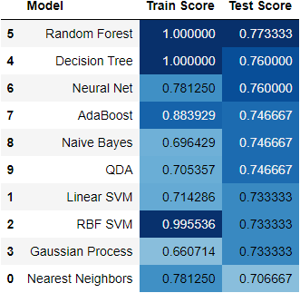
ML MODEL DEVELOPMENT – MODEL SELECTION
Ten standard skLearn classification models evaluated with default parameters for a high-level model selection process
Random Forest Model selected based upon consistent performance with multiple data splits
Additional model research could be performed with Keras/TensorFlow in the future

Slide 8
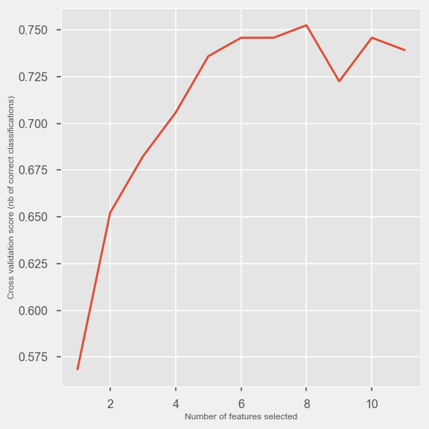
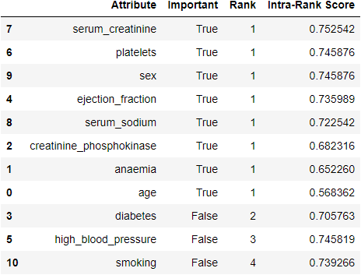
ML MODEL DEVELOPMENT – FEATURE SELECTION
Recursive Feature Elimination Cross-Validation*
Cross-Validation Score*

Slide 9
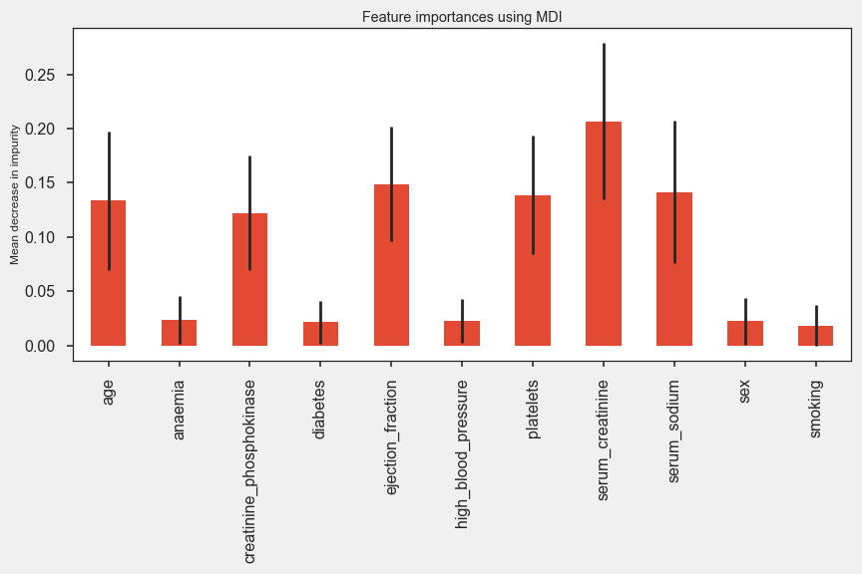
ML MODEL DEVELOPMENT – FEATURE SELECTION
MDI – Mean Decrease in Impurity
Deterministic feature selection
Correlates well with probabilistic RFECV feature selection modeling
Feature importance aligns with original study of attribute importance:
Serum Creatinine
Ejection Fraction
Go to your Doctor!!!
Lab results are important

Slide 10
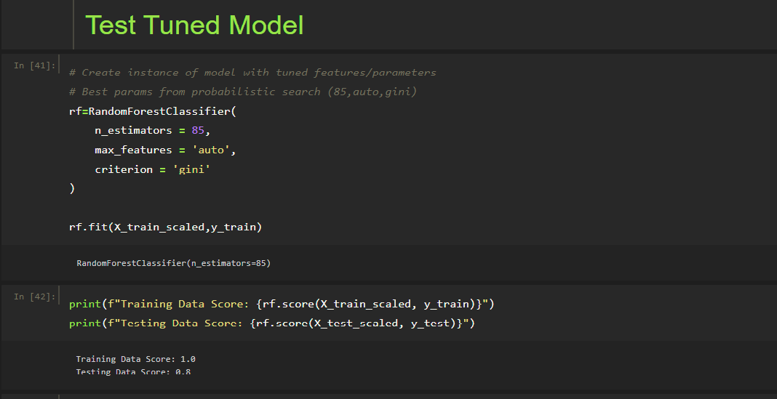
ML MODEL DEVELOPMENT – PARAMETER SELECTION
Tuned Parameters
n_estimators – Number of trees in the forest
85
max_features – The number of features to consider when looking for the best split
auto: max_features=sqrt(n_features)
Criterion – The function to measure quality of a split
Gini: a measure that the decision tree tries to minimize when splitting each node. Represents the probability that a randomly selected sample from a node will be incorrectly classified according to the distribution of samples in the node.

Slide 11
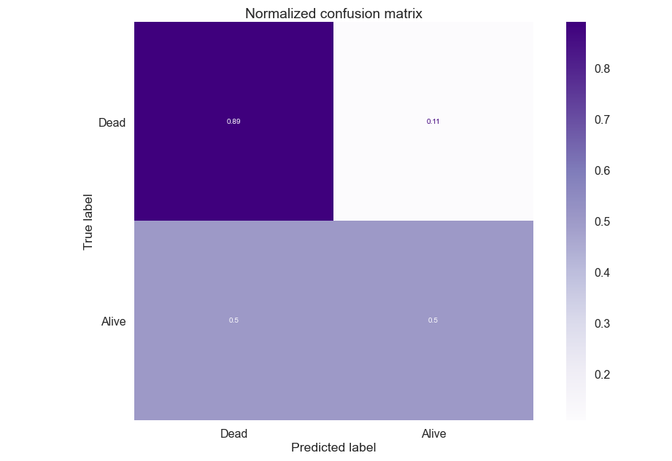
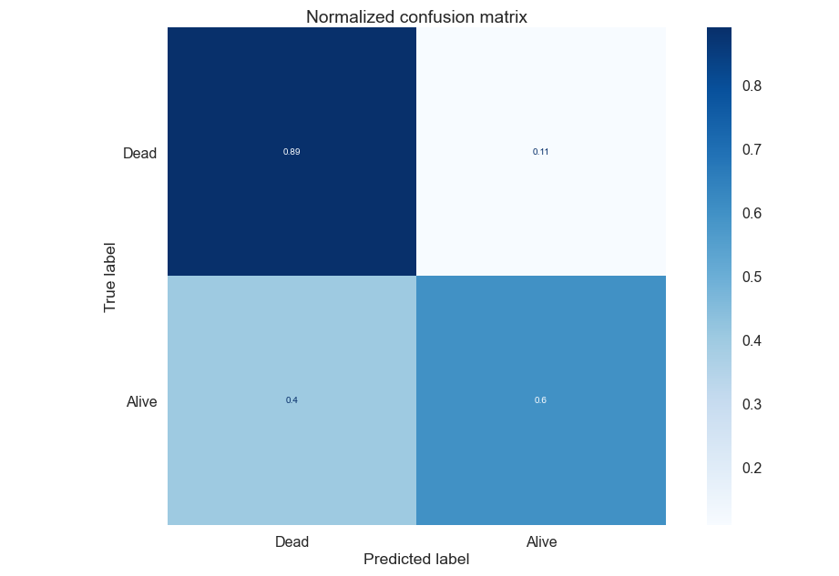
ML MODEL DEVELOPMENT – HP TUNING
Default Parameters
Tuned Parameters w/GridSearchCV
25% Reduction in Type I Error with Hyper-Tuned Model

Slide 12








APPLICATION DEVELOPMENT - TECHNOLOGIES

Slide 13











APPLICATION DEVELOPMENT - ARCHITECTURE
Client - hospital
App on the cloud = high availability/accessibility
Client - pharmacy
Request
Response
Model trained offline and uploaded to the cloud app
Client – medical schools

